Slide 1
Jewish on Campus… Beyond Hillel
Eli Shavalian אליהו
Director of College Counseling
Shalhevet High School
Sarah Blank שרה
MBA Candidate
University College Dublin

Slide 2
Today’s Discussion & Goals
History & context
The Jewish college experience today
Advising Jewish college bound students
Understand how we got here
Understand why Jewish students need to be included in our activism
Leave with tangible resources to share with Jewish students & colleagues

Slide 3
History & Context
Ethno-religion & Jewish diaspora
Jewish people make up just .2% of world population but are 60% of religious hate crimes in US. (Less than 15 million Jews worldwide)
Antisemitic incidents in the United States hit a four-decade high in 2019
The most visibly Jewish are often the most vulnerable
1 in 3 American Jews conceals outwards indications of Jewishness
Higher Education exclusion

Slide 5
Antisemitism & Anti-zionism
IHRA definition of antisemitism
Not tied to one part of political spectrum
Zionism & Anti-Zionism
Education in America
16 states mandate Holocaust teaching
Ex: CA Ethic Studies Curriculum
Sources:
www.holocaustremembrance.com
American Jewish Committee
ADL.org

Slide 6
The Jewish Student Experience
The Calendar
Move-in, midterms, finals
High Holidays, Fast Days, Days of “no work”
Campus Dining
Fully kosher kitchens
Kosher style
Housing
Proximity to Jewish life
Kitchens

Slide 7
The Jewish Student Experience
Student Support
Hillel
Chabad
Local Synagogues
Jewish Federations
Interfaith Dialogue
Community Involvement
Student-run Organizations
Boycott, Divestment & Sanctions
Students for Justice in Palestine
Students Supporting Israel

Slide 8
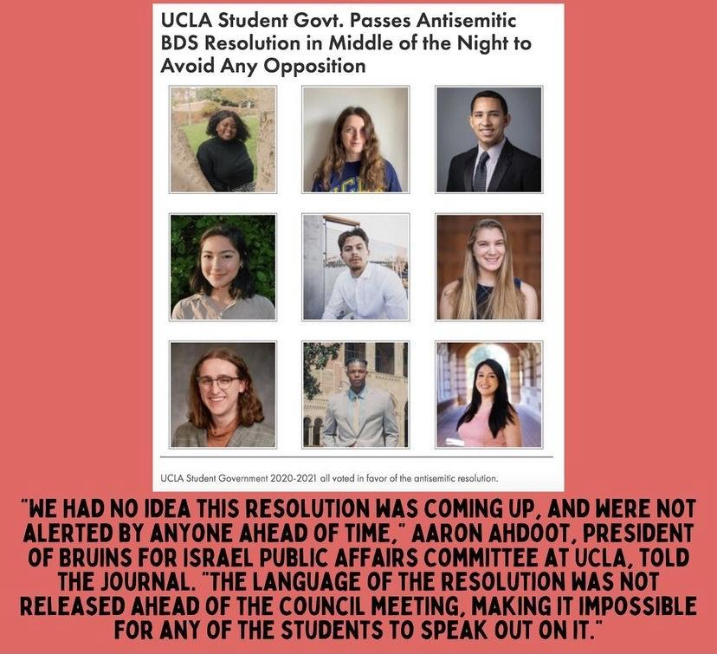
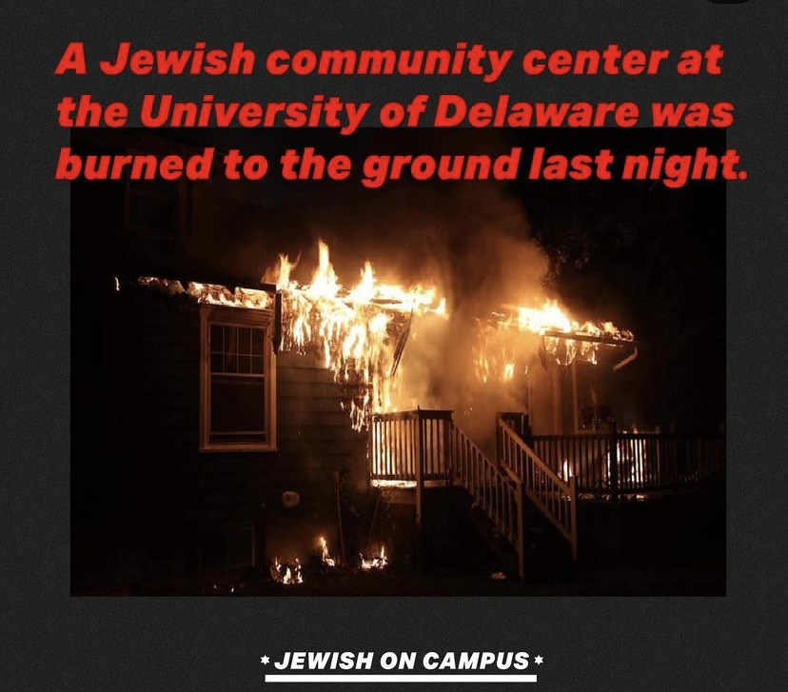
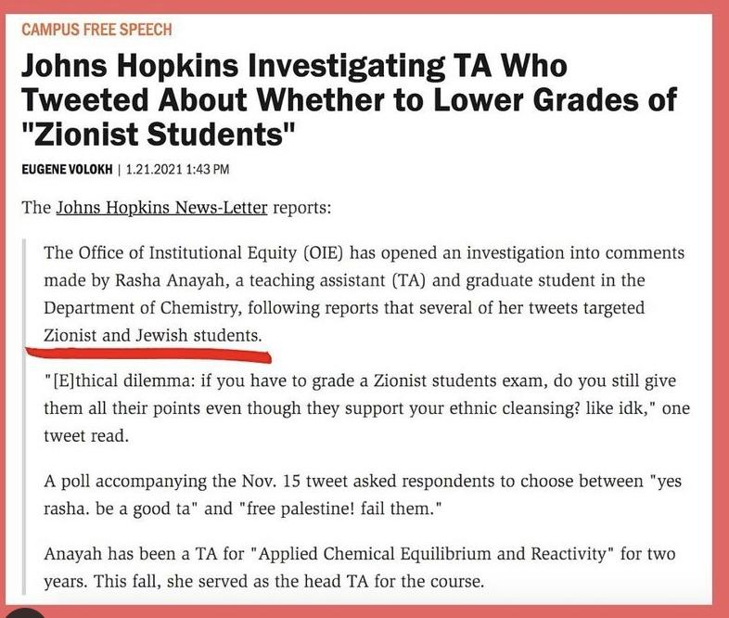

Slide 9
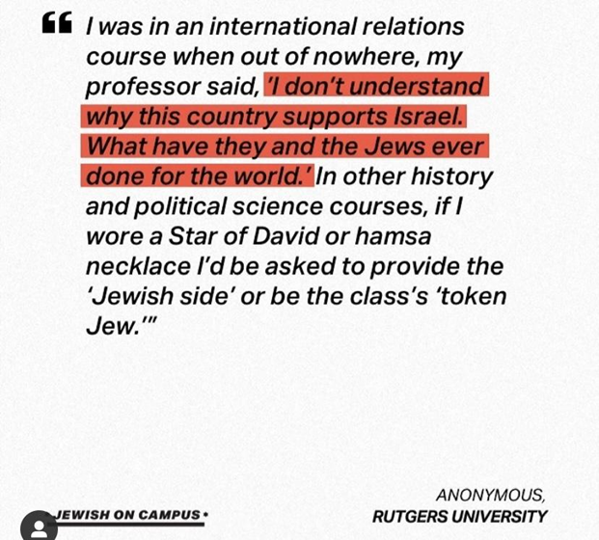
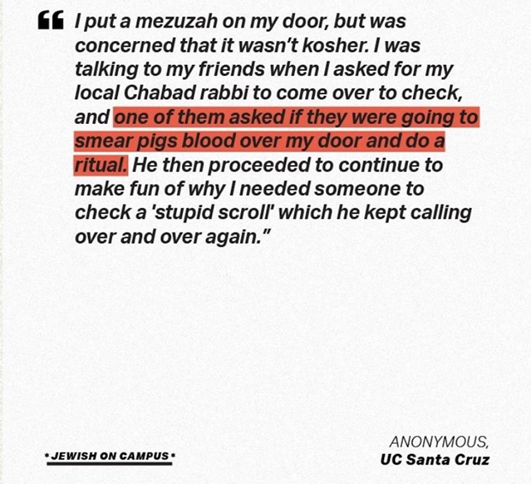
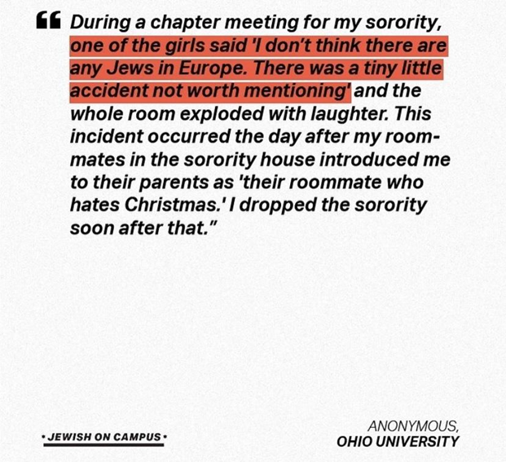
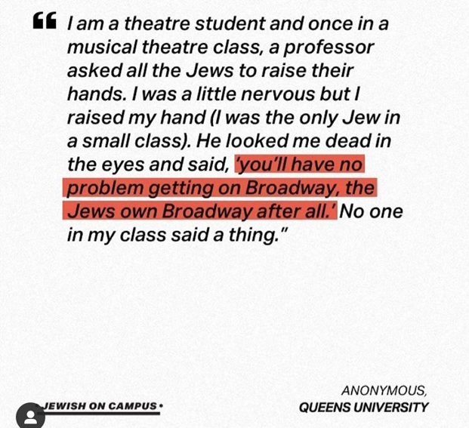
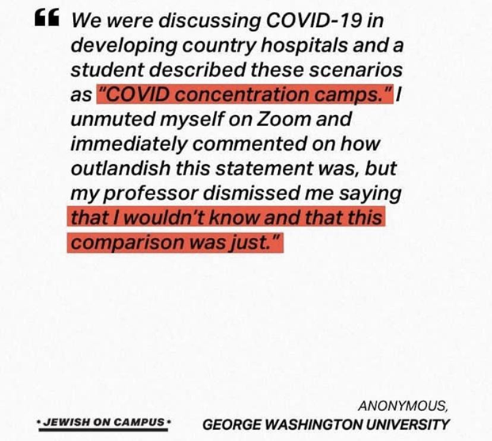

Slide 10
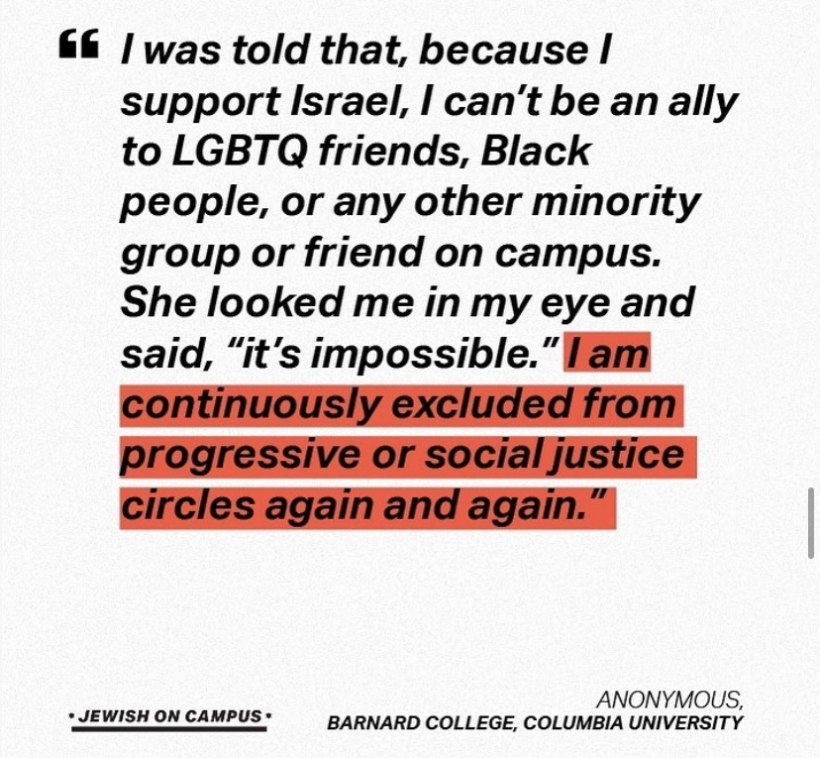
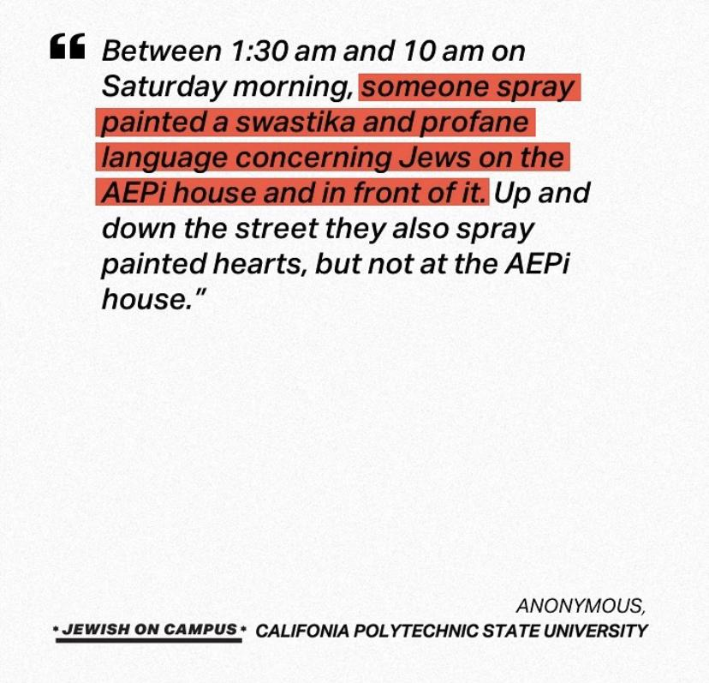
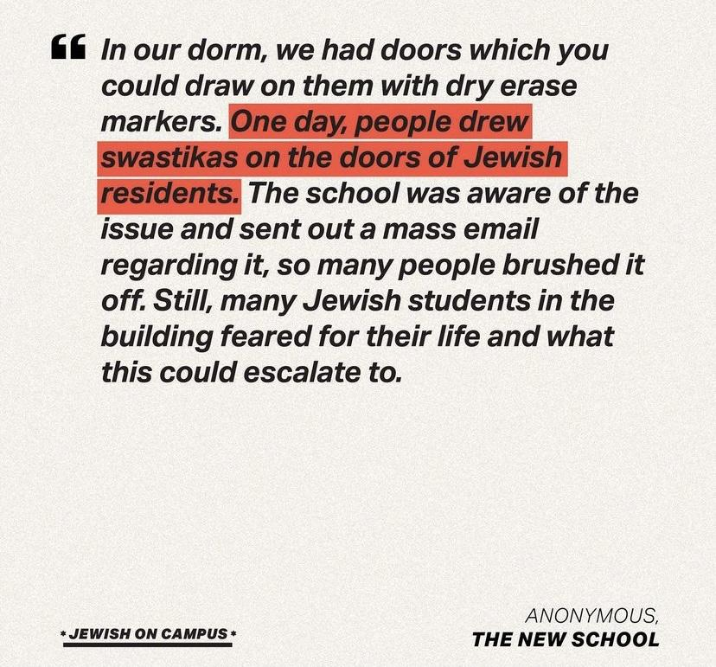
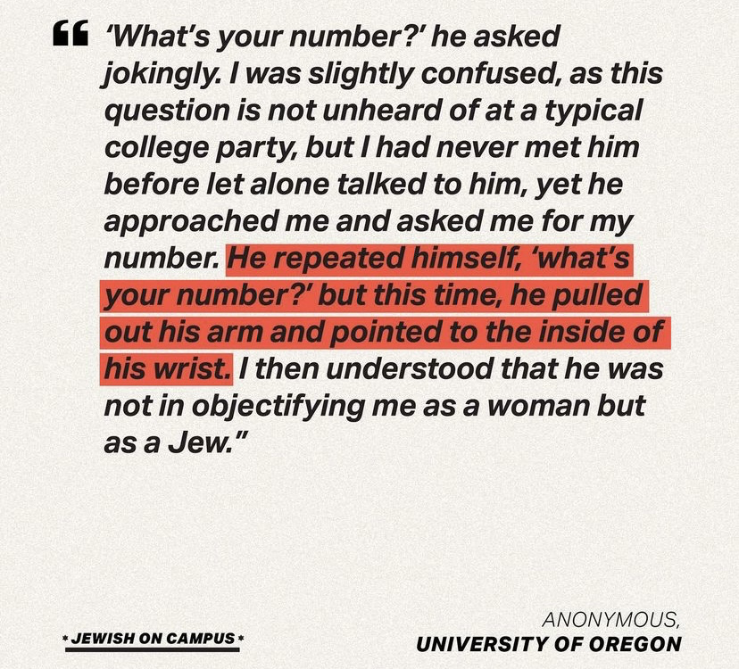
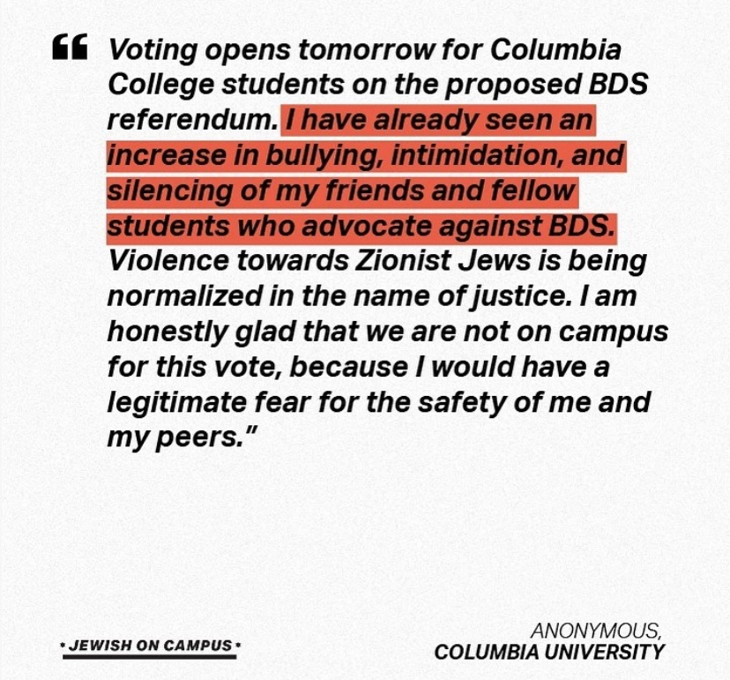
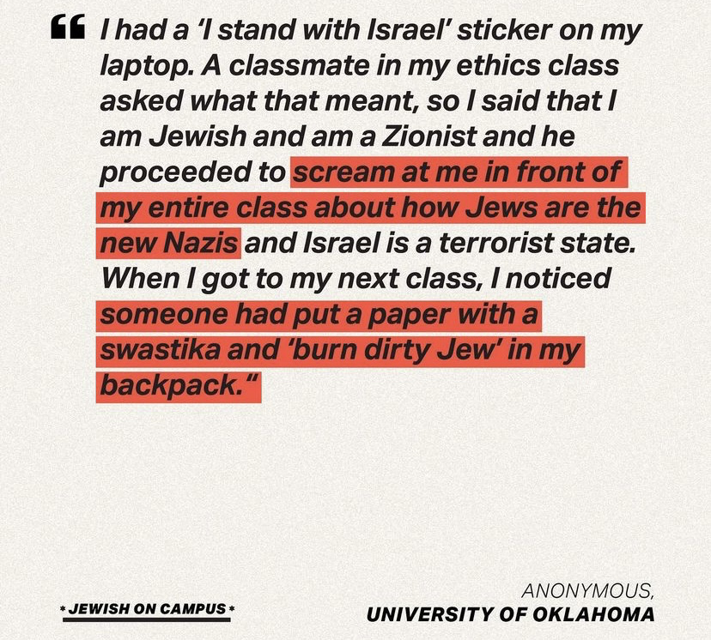

Slide 11
Advising Jewish Students – High School Perspective
What does “fit” mean for a Jewish student?
Identity/values
Chabad/Hillel
What if I’m “too” Jewish?
Revealing observance in short answers/essay
Explaining Jewish clubs & volunteer opportunities
If you build it, will they come?
Chicken or the egg
Critical mass of observant students
Resources
Hillel's College Guide
Kosher food on campus
OU - Jewish Learning Initiative on Campus

Slide 12
Advising Jewish Students - College Perspective
Be prepared to discuss “fit” while recruiting
Know your campus - what student groups are present?
Know your community - what resources does your campus offer in interfaith dialogue, religious organizations, worship houses, synagogues.
Extracurricular list & essays on Jewish identity & involvement
Youth Groups (BBYO, NFTY), summer camp, synagogue involvement
What’s in the news?
Be honest

Slide 13
אם אין אני לי,מי לי? וכשאני לעצמי,מה אני? ואם לא עכשיו,אימתי
“If I am not for myself, who will be for me? If I am only for myself, what am I? And if not now, when?”

Slide 14
Reflection Questions
How can you signal to your Jewish students that you are a person they can feel comfortable opening up to about their religious needs?
What’s one tangible step you can take to further support your Jewish students?
Where do you get your news?
Notes:
ELI

Slide 15
Thank You!

Slide 16
Sources & Further Reading
Hillel's College Guide
Kosher food on campus
OU - Jewish Learning Initiative on Campus
https://www.hillel.org/jewish/campus-climate-initiative
https://www.adl.org/resources/backgrounders/about-the-ihra-working-definition-of-antisemitism

