Slide 1
Entering the US system as a transfer student: Why is it so complicated?
Jen Singer
University of Wisconsin-Milwaukee

Slide 2
Making Decisions for Non-Transfers
A complete credential
Benchmarks to compare
Preparation to begin a new program

Slide 3
Making Decisions for Transfers
Evaluation of partial credential AND how it blends with the new program
Common language with different meanings
Transfer credit vs. Credits towards degree requirements
Decisions may span several offices (Admissions, Registrar's Office, Advisors)

Slide 4
Assumptions of Transfer Students
Cohort model
Admitted is admitted
Pass by term, not individual courses
Predictable time/$$
Example – Kathmandu University

Slide 5
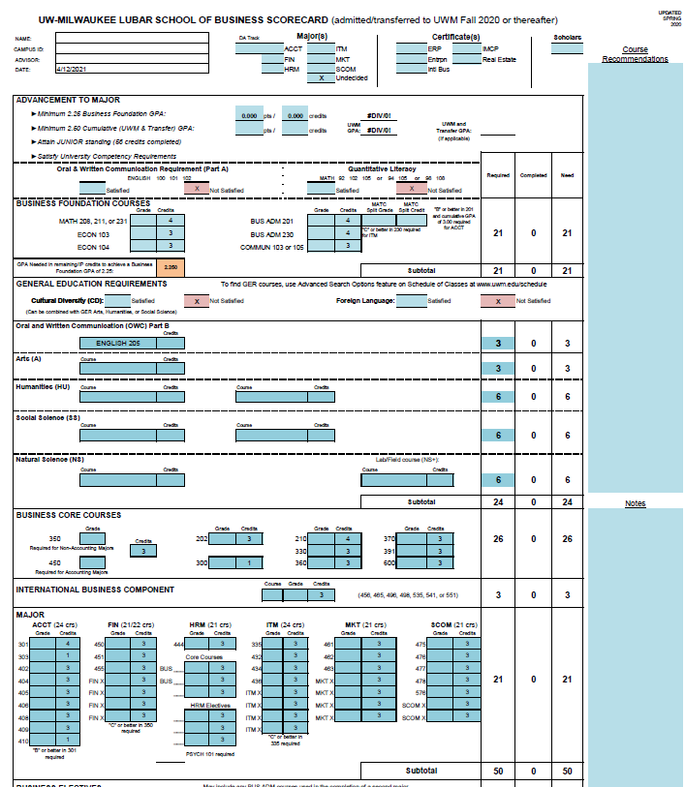
Realities of the US Education System
Individual courses/credits
GERs/Major/Electives
Pre-requisites
Placement testing
Unpredictable time/$$

Slide 6
An Example
Russian university
Verify accreditation and validity
Convert the grades and GPA to US 4.0
Credit equivalency

Slide 7
UWM: Congratulations! You are admitted!

Slide 8
Student: Great news! How many credits am I going to get?
Transfer credits is a make-or-break issue:
Time to degree
Cost
Assumptions:
3 years done = 1 year to complete
Business courses

Slide 9
Transfer Credit vs. Degree Requirements

Slide 10
Considerations to Commitment
Assumptions
Reality
79 credits transferred
1 year to graduation
Business courses
Resident: $10,000
Non-Resident: $22,000
13 credits count
3.5 years to graduation
Business + GER courses
Resident: $35,000
Non-Resident: $75,000

Slide 11
Another Case Study – A Partnership
What makes it different?
Time to prepare
Faculty review of coursework
Flexibility
Easier processing
Preparation for English and Math

Slide 12
3+1
Long standing UWM partner
Pressure on UWM by Chinese government to be successful
Significant time spent on transfer credit planning
UWM on the ground in China
Three year wait for first students
5-15 students per cohort

Slide 13
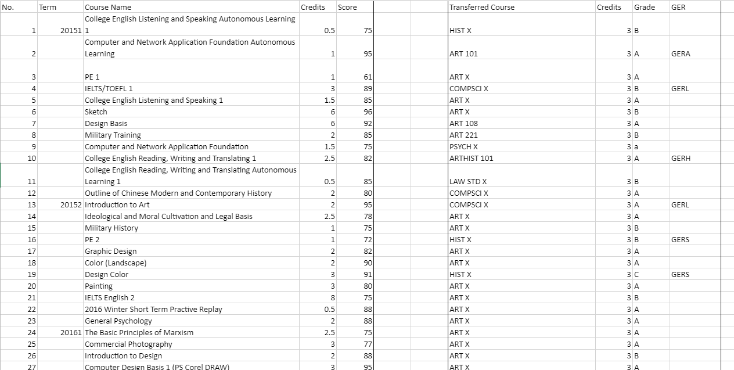

Slide 14
Challenges
Students rarely had taken the exact planned courses
Failed courses
Missing pre-requisites
English deficiencies
Math deficiencies
Scrambling to change equivalencies
Not all students treated the same

Slide 15
Making Decisions for Transfers
Evaluation of partial credential AND how it blends with the new program
Common language with different meanings
Transfer credit vs. Credits towards degree requirements
Decisions may span several offices (Admissions, Registrar's Office, Advisors)

Slide 16
Document Links
Kathmandu University - http://chem.ku.edu.np/course
Business Degree Requirements – Not Available to Share
Russian Transcript, English Translation - https://panthers-my.sharepoint.com/:b:/g/personal/jksinger_uwm_edu/EU8EDxK3NNZEkxUdSMJng6YBYOY-VVqze14CgEd-rqc6Bg?e=Ca2EQG
Russian Transfer Credit with Equivalencies - https://panthers-my.sharepoint.com/:x:/g/personal/jksinger_uwm_edu/EU5vMfg1okFAgRheNd93zVEB-pjvave0sLyaZOqZtqZ2ng?e=qObuhY
Partnership Transcript - https://panthers-my.sharepoint.com/:b:/g/personal/jksinger_uwm_edu/ET6MSP6ZLvRMpP2DR6YCU64Bx754ej1QCYfTH9KCxOXywQ?e=cap2Kw
Partnership Transfer Credit with Equivalencies - https://panthers-my.sharepoint.com/:x:/g/personal/jksinger_uwm_edu/Ed3HzeKcjQZGijAe5Beihf4B75qDO4s1nuZQRAgBUpL8RQ?e=9RZVEr

Slide 17
Questions? Discussion? Comments?
Jen Singer
Assistant Director for International Admissions
University of Wisconsin-Milwaukee
Jksinger@uwm.edu

